Slide 1
Ontology Architecture
for
Metal Cutting Tooling System

Slide 2
Need
Identification of tools for a specific application
Restricted to highly skilled application engineer, Tool Supplier, Tool Mfg
Awareness of cutting tool technology
High temperature applications
Thin walled structures
Niche applications like deep boring, complex surface machining
Suitability of a machine + tooling system
Machine specific stability of particular tool for a particular process

Slide 3
Current Tool Selection
www.kennametal.com
https://www.sandvik.coromant.com/en-gb/pages/default.aspx
Or resort to catalogues
Or to experts

Slide 4
What can be queried
A suitable insert for machining
For internal turning of aluminium with low Si% less than 12
Tool holder and adapter for external turning
A solid carbide drill for drilling Inconel
What is the drill speed and axial feed
Alternate tooling options -
Suitable feed and speed rates for boring austenitic stainless steel
What are the suitable tools that can be used with a particular machine
Or it inverse
What grade of insert has wear resistance and toughness?
What are the uncoated
Preferred insert geometry for machining aluminium
Tool holder / adapter for undercut boring

Slide 5
What can be queried
Is the insert and too available at a particular shopfloor
For internal turning of aluminium with low Si% less than 12
Tool holder and adapter for external turning
What insert grades can machine aluminum?
Why?
What insert has multi layer coating?
What insert can give mirror quality surface finish?
Or it inverse
What cermet insert grades are available?
Ceramic insert having PVD coating
Or PVD coating
What materials cermet grades can machine?
What coating technologies are used for coating
What are the inserts that have C4 coating class

Slide 6
Visual representation
Material
Machine
Tool Holder
Coating Material
P
N
Canbeused
S
Feed, Speed, DoC
Type
M
Spindle taper
TiC
TICN
K
Coating Technology
Stability
Al2O3
adaptor
TiN
SL
TiN
ML
CVD
PVD
UN
has Coating Material
usedformachining
usedwith
Insert Grade
Coating Applied
hasinsertgrade
Inserts
Tools
Solid Tools
PCD
Manufactures
Uncoated
PCBN
issuitablefor
threading
Manufacturer
Cermets
PVD Coated Carbide
turning
Machining Operation
KM
ISCAR
CVD Coated Carbide
boring
milling
Sandvik

Slide 7
Insert Grade
Refers to the Substrate and Coating of the insert, mostly some carbide with some single or multi layer coating
Defines its properties such as toughness, wear resistance, etc and suitable for particular material group
Coating on Grade | Grade | Substrate and Coating | Materials that can be processed with this grade | Annotations
Uncoated Carbide | K313 | Unalloyed WC/Co (Tungsten Carbide with Cobalt binder), fine grained | M, K, N, S | Exceptional edge wear resistance combined with very high strength Superior thermal deformation and depth of cut notch resistance
 | K68 | Unalloyed WC/Co (Tungsten Carbide with Cobalt binder), fine grained | M, K, N, S | excellent abrasion resistance

Slide 8
Insert Grade
Coating on Grade | Grade | Substrate and Coating | Materials that can be processed with this grade | Annotations
PVD Coated Carbide | KC5010 | unalloyed carbide substrate with PVD coating of TiAlN (Titanium Aluminium Nitride) | P, M, K, N, S Partly H | very deformation resistant machining of hardened and short chipping materials Roughing, semi-finishing and finishing at higher speeds
PVD Coated Carbide | KC5025 | ultra-fine grain unalloyed substrate with PVD coating of TiAlN (Titanium Aluminium Nitride) | P, M, K, N, S | Tough Roughing, semi-finishing and finishing at low to medium speeds Handle interrupted cutting and high feed rates

Slide 9
Insert Grade
Coating on Grade | Grade | Substrate and Coating | Materials that can be processed with this grade | Annotations
PVD Coated Carbide | KC5410 | Unalloyed carbide substrate with PVD coating of TiB2 (Titanium Diboride), fine grained | N | reduced surface friction, speedy chip flow and outstanding wear resistance built-up edge is prevented because this coating has a very low affinity for aluminum Sharp edges Roughing, semi-finishing and finishing excellent thermal deformation resistance and edge integrity

Slide 10
Insert Grade
Coating on Grade | Grade | Substrate and Coating | Materials that can be processed with this grade | Annotations
PVD Coated Carbide | KC5510 | tungsten carbide substrate with 6% cobalt and PVD coating of TiAlN (Titanium Aluminium Nitride), fine-grained | P, M, K, N, S Partly H | Specially designed for high-temperature alloys at speeds double the conventional PVD coating due to 6% cobalt excellent toughness and deformation resistance
PVD Coated Carbide | KC5525 | tungsten carbide substrate with 10% cobalt and PVD coating of TiAlN (Titanium Aluminium Nitride), fine-grained | P, M, K, N, S | Higher cobalt allows for interrupted cutting Medium and heavy interrupted cuts Tungsten carbide resist deformation at higher speeds

Slide 11
Insert Grade
Coating on Grade | Grade | Substrate and Coating | Materials that can be processed with this grade | Annotations
PVD Coated Carbide | KU10T | carbide substrate and PVD coating of TiAlN (Titanium Aluminium Nitride) and TiN (Titanium Nitride), fine-grained | P, M, K, N, S Partly H | highly deformation resistant Multi-layer coating Semi finishing and finishing machining hardened and short-chipping materials
PVD Coated Carbide | KU25T | carbide substrate and PVD coating of TiAlN (Titanium Aluminium Nitride) and TiN (Titanium Nitride), fine-grained | P, M, K, N, S | Has higher cobalt content than KU10T grade Suitable for grooving, threading, cut-off operations Roughing, semi-finishing and finishing machining hardened and short-chipping materials Multi-layer coating

Slide 12
Insert Grade
Coating on Grade | Grade | Substrate and Coating | Materials that can be processed with this grade | Annotations
CVD Coated Carbide | KC8050 | advanced cobalt-enriched carbide substrate and CVD coating of TiCN (Titanium Carbo Nitride), thick Al2O3(Aluminium Oxide) and TiN (Titanium Nitride), fine-grained | P, M, K | highly wear resistant and can operate without coolant at high speeds Multi-layer coating Roughing, Semi finishing and Finishing Excellent edge strength and suitable for interrupted machining resists workpiece build-up and microchipping
 | KC9040 | cobalt-enriched Carbide substrate with CVD coating - TiN (Titanium Nitride / thick Al2O3(Aluminium Oxide) / TiC (Titanium Carbide) / TiCN (Titanium Carbo Nitride) | P | heavy roughing High toughness Multi layer coating

Slide 13
Insert Grade
Coating on Grade | Grade | Substrate and Coating | Materials that can be processed with this grade | Annotations
CVD Coated Carbide | KC9110 | advanced cobalt-enriched carbide substrate with CVD coating of thick MT-TiCN (medium temperature Titanium Carbo Nitride), thick Al2O3(Aluminium Oxide) and TiN (Titanium Nitride), | P, K | Maximum wear resistance Semi-finishing and finishing cobalt-enriched substrate offers a balanced combination of deformation resistance and edge toughness thick coating layers offer outstanding abrasion resistance and crater wear resistance for high-speed machining resistance to edge build-up and microchipping and produces excellent surface finishes

Slide 14
Insert Grade
Coating on Grade | Grade | Substrate and Coating | Materials that can be processed with this grade | Annotations
CVD Coated Carbide | KC9125 | advanced cobalt-enriched carbide substrate with CVD coating of thick MT-TiCN (medium temperature Titanium Carbo Nitride), thick Al2O3(Aluminium Oxide) and TiN (Titanium Nitride) | P, M, K | Coating has superior inter layer adhesion than KC9110 Maximum wear resistance Roughing, Semi-finishing cobalt-enrichment, assures adequate deformation resistance along with excellent bulk toughness and insert edge strength Reduced frictional heat, minimizes microchipping, and improves workpiece surface finishes thick coating layers offer outstanding abrasion resistance and crater wear resistance for high-speed machining resistance to edge build-up and microchipping and produces excellent surface finishes

Slide 15
Insert Grade
Coating on Grade | Grade | Substrate and Coating | Materials that can be processed with this grade | Annotations
CVD Coated Carbide | KC9140 | Tough carbide grade Multi-layered coating TiN / Al2O3 / MT-TiCn / TiN | P | Roughing applications of alloy steel Long tool life High edge strength
 | KC9225 | Cobalt enriched carbide Multi-layered coating: TiN / Al2O3 / MT-TiCN / TiN | P, M | Resistance to depth-of-cut notching Reduced burr formation Toughness and deformation resistance Minimal build-up edge formations Produces superior surface finish

Slide 16
Insert Grade
Coating on Grade | Grade | Substrate and Coating | Materials that can be processed with this grade | Annotations
CVD Coated Carbide | KC9240 | Carbide Multilayered CVD coating: TiN / Al2O3 / MT-TiCN / TiN | P, M | Suitable for tough applications with moderate speed and feed-rates Toughness, built-up edge resistant and wear resistance Excellent thermal and mechanical shock resistant
 | KC9245 | Super tough carbide substrate Multilayered CVD coating: TiN / Al2O3 / MT-TiCN / TiN | P, M | Machining of stainless steel Withstands heavy interruptions Resist build-up edge formation Suitable for heavy feed-rates and depth of cuts (DoC)

Slide 17
Insert Grade
Coating on Grade | Grade | Substrate and Coating | Materials that can be processed with this grade | Annotations
CVD Coated Carbide | KC9315 | Carbide substrate Multi-layered CVD coating: TiN / Al2O3 / MT-TiCN | P, M, K | Multi-layered coating Maximum wear resistance Longer tool life Machining of ductile and cast iron Suitable for interrupted cutting
 | KC9325 | Carbide substrate Al2O3 / TiCN | P, K | Multi-layered coating Machining of ductile or cast iron
 | KU30T | Tough cobalt enriched substrate Multi-layered CVD coating: TiN / TiCN / TiN | P, M, K, S | For wide range of work materials Roughing to finishing Post coating treatment resists build-up edge and micro-chipping

Slide 18
Insert Grade
Coating on Grade | Grade | Substrate and Coating | Materials that can be processed with this grade | Annotations
PVD - Coated cermet | KT315 | Multi-layered PVD TiN / TiCN / TiN coated - turning grade | P, M, K | Multi-layered coating High speed machining. Long and consistent tool life Produces excellent surface finish

Slide 19
Insert Grade
Coating on Grade | Grade | Substrate and Coating | Materials that can be processed with this grade | Annotations
Uncoated Ceramics | KY1310 | Advanced Sialon ceramic grade - No coating | K | Maximum wear resistance High speed continuous turning
 | KY1525 | SiC (Silicon Carbide) - reinforced aluminium oxynitirde - No coating | S | Wear resistance, edge toughness and thermal shock resistant Finish machining of high temperature alloys Excellent depth-of-cut notch resistant

Slide 20
Insert Grade
Coating on Grade | Grade | Substrate and Coating | Materials that can be processed with this grade | Annotations
Uncoated Ceramics | KY1540 | Advanced Sialon material - No coating | S | Excellent wear properties, fracture toughness and thermal shock resistant Provides superior depth-of-cut notch resistant
 | KY1615 | Advanced alumina/TiC (Titanium Carbide) ceramic (black) - No coating | K, H | Toughness and wear resistant Machining of steels with hardness above 60 HRC

Slide 21
Insert Grade
Coating on Grade | Grade | Substrate and Coating | Materials that can be processed with this grade | Annotations
Uncoated Ceramics | KY2100 | Advanced Sialon grade - No coating | K, H | Mechanical shock resistant Wear resistant Machining of high-temperature alloys
Coated Ceramics | KY3400 | CVD coated pure silicon nitride (SiN) grade | S | Toughness Edge wear resistant

Slide 22
Insert Grade
Coating on Grade | Grade | Substrate and Coating | Materials that can be processed with this grade | Annotations
Uncoated Ceramics | KY3500 | Pure silicon nitride (SiN) grade - No coating | K | Toughness High feed-rates for rough machining Suitable for machining through interruptions
Coated Ceramics | KY4400 | PVD TiN coating over aluminium oxide (Al₂O₃) and titanium carbonitride ceramic (TiCN) | H | Finish turning of hardened steels and irons with hardness above 45 HRC Finish turning of powder metals, nickel alloys and cobalt alloys

Slide 23
Insert Grade
Coating on Grade | Grade | Substrate and Coating | Materials that can be processed with this grade | Annotations
PCBN – Polycrystalline Cubic Boron Nitride | KB5625 | PVD TiAlN coating over a PCBN tip brazed on to a carbide insert | H | Machining of hardened steels (bearing steel, hot and cold worked tool steel, die steels and hard coatings) with hardness >45 HRC
 | KB9610 | PCBN grade with a TiN/Al2O3/TiCn CVD coating | K, H | Multi layered coating Precision machining of hardened steels (bearing steel, hot and cold worked tool steel, die steels and hard coatings) with hardness > 48 HRC Multi-tip format with edge preps and wiper geometries

Slide 24
Insert Grade
Coating on Grade | Grade | Substrate and Coating | Materials that can be processed with this grade | Annotations
PCBN – Polycrystalline Cubic Boron Nitride | KB9640 | High CBN content, solid PCBN structure with multiple cutting edges and a CVD alumina coating | K, H | Machining of hardened steels and irons with hardness >45 HRC
 | KD120 | High CBN content, PCBN tip brazed onto a carbide insert | K, H | Machining of hardened steels and irons with hardness >45 HRC

Slide 25
Insert Grade
Coating on Grade | Grade | Substrate and Coating | Materials that can be processed with this grade | Annotations
PCD - Polycrystalline Diamond | KD100 | Polycrystalline Diamond tip - brazed on to carbide substrate - No coating | N | Produces good surface finish Best mechanical shock resistant Sharp and operates and higher speeds
 | KD1405 | CVD (chemical vapour deposition) deposited diamond sheet tool - brazed onto carbide substrate - No coating | N | Abrasion resistant suitable for non-ferrous metals and non-metallic materials

Slide 26
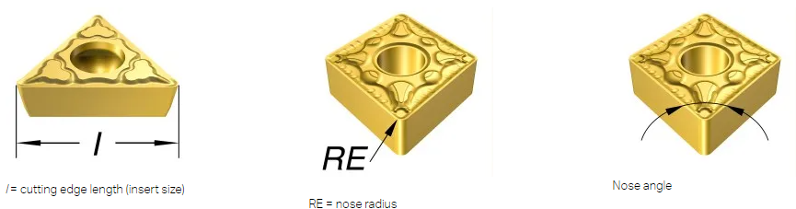
Turning Insert Designation
Shape | Clearance Angle | Tolerance | Groove / Hole | Size | Thickness | Nose Radius

Slide 27
Milling Insert Designation
Shape | Clearance Angle | Tolerance | Hole / Chipbreaker | Size | Thickness | Nose Radius | Wiper lead Angle | Wiper Clearance Angle | Cutting Edge Preparation | Cutting Direction

Slide 28
Insert Geometry
-
Shape
Code | Description | Nose Angle
A | 85 parallelogram | 85
B | 82 parallelogram | 82
C | 80 rhombic | 80
D | 55 rhombic | 55
E | 75 rhombic | 75
H | Hexagon | 120
K | 55 parallelogram | 55
L | Rectangle | 90
M | 86 Rhombic | 86

Slide 29
Insert Geometry
-
Shape
Code | Description | Nose Angle
N | 55 parallelogram | 55
O | Octagon | 135
P | Pentagon | Full Radius
R | Round | 55
S | Square | 90
T | Triangle | 60
V | 35 Rhombic
W | Trigon | 80
X | Any special parallelogram | 85

Slide 30
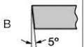
Insert Geometry
-
Clearance Angle
Code | Angle
N | 0
A | 3
B | 5
C | 7
P | 11
D | 15
E | 20
F | 25
G | 30
Clearance angle

Slide 31

Insert Geometry
-
Tolerance
Code | Corner Point (mm) | Thickness (mm) | Inscribed Circle (mm)
A | 0.005 | 0.025 | 0.025
C | 0.013 | 0.025 | 0.025
E | 0.025 | 0.025 | 0.025
F | 0.005 | 0.025 | 0.013
G | 0.025 | 0.13 | 0.025
H | 0.013 | 0.025 | 0.013
J | 0.005 | 0.025 | 0.05 - 0.13
K | 0.013 | 0.025 | 0.5 - 0.13
L | 0.025 | 0.025 | 0.5 - 0.13
M | 0.05 - 0.13 | 0.13 | 0.5 - 0.15
U | 0.06 - 0.025 | 0.13 | 0.08 - 0.25
Corner Point / Nose height
Inscribed circle
Thickness
Tolerance on the dimensions represented in above figures, not the dimensions themselves

Slide 32

Insert Geometry
-
Hole / Chip Breaker
Code | Mounting Hole | Hole Shape | Chipbreaker
Null | No | - | None
A | Yes | Cylindrical | None
B | Yes | 70 - 90° Countersink | None
D | Yes | Cylindrical | None
E | No | - | None
F | No | - | Double sided
G | Yes | Cylindrical | Double sided
H | Yes | 70 - 90° Countersink | Single sided
M | Yes | Cylindrical / Double Countersink | Single sided
Mounting hole

Slide 33
Insert Geometry
-
Hole / Chip Breaker
Code | Mounting Hole | Hole Shape | Chipbreaker
N | No | - | None
P | Yes | Cylindrical | Hi-double positive
Q | Yes | 40 - 60° Countersink | None
R | No | - | Single sided
S | Yes | Cylindrical | Hi-double positive
T | Yes | 40 - 60° Countersink | Single sided
U | Yes | 40 - 60° Countersink | Double sided
W | Yes | 40 - 60° Countersink | None
Z | Yes | Cylindrical | Double sided or Hi-double positive
Mounting hole

Slide 34
Insert Geometry
-
Size
ANSI CODE | Inscribed Circle Size |  | ISO Code Cutting Edge Length (mm) for specific Insert Shapes
 | (in) | (in) | C | D | R | S | T | V | W
0.5 | 0.0625 | 1/16 | - | - | - | - | - | - | -
1.2 (5) | 0.15625 | 5/32 | S4 | 04 | 03 | 03 | 06 | - | -
1.5 (6) | 0.1875 | 3/16 | 04 | 05 | 04 | 04 | 08 | 08 | S3
1.8 (7) | 0.21875 | 7/32 | 05 | 06 | 05 | 05 | 09 | 09 | 03
2 | 0.25 | 1/4 | 06 | 07 | 06 | 06 | 11 | 11 | 04
2.5 | 0.3125 | 5/16 | 08 | 09 | 07 | 07 | 13 | 13 | 05
3 | 0.375 | 3/8 | 09 | 11 | 09 | 09 | 16 | 16 | 06
3.5 | 0.4375 | 7/16 | 11 | 13 | 11 | 11 | 19 | 19 | 07
4 | 0.5 | 1/2 | 12 | 15 | 12 | 12 | 22 | 22 | 08

Slide 35
Insert Geometry
-
Size
ANSI CODE | Inscribed Circle Size |  | ISO Code Cutting Edge Length (mm) for specific Insert Shapes
 | (in) | (in) | C | D | R | S | T | V | W
4.5 | 0.5625 | 9/16 | 14 | 17 | 14 | 14 | 24 | 24 | 09
5 | 0.625 | 5/8 | 16 | 19 | 15 | 15 | 27 | 27 | 10
5.5 | 0.6875 | 11/16 | 17 | 21 | 17 | 17 | 30 | 30 | 11
6 | 0.75 | 3/4r | 19 | 23 | 19 | 19 | 33 | 33 | 13
6.5 | 0.8125 | 13/16
7 | 0.875 | 7/8 | 22 | 27 | 22 | 22 | 38 | 38 | 15
8 | 1 | 1 | 25 | 31 | 25 | 25 | 44 | 44 | 17
10 | 1.25 | 1-1/4 | 32 | 38 | 31 | 31 | 54 | 54 | 21
 | 1.26 |  |  |  | 32

Slide 36
Insert Geometry
-
Thickness
ANSI Code | ISO Code | Thickness (in) | Thickness(in) | Thickness (mm)
.5 (1) | - | 0.03125 | 1/32 | 0.79
0.6 | T0 | 0.040" | - | 1.00
1 (2) | 1 | 0.0625 | 1/16 | 1.59
1.2 | T1 | 0.078 | 5/64 | 1.98
1.5 (3) | 2 | 0.094 | 3/32 | 2.38
 | T2 | 0.109 | 7/64 | 2.78
2 | 3 | 0.125 | 1/8 | 3.18

Slide 37
Insert Geometry
-
Thickness
ANSI Code | ISO Code | Thickness (in) | Thickness(in) | Thickness (mm)
2.5 | T3 | 0.156 | 5/32 | 3.97
3 | 4 | 0.187 | 3/16 | 4.76
- | 5 | 0.219 | 7/32 | 5.56
4 | 6 | 0.25 | 1/4 | 6.35
5 | 7 | 0.313 | 5/16 | 7.9
6 | 9 | 0.375 | 3/8 | 9.53
8 | - | 0.5 | 1/2 | 12.7

Slide 38
Insert Geometry
-
Radius
ANSI Code | ISO Code | Nose Radius (in) | Nose Radius (in) | Nose Radius (mm)
Null | Null | Wiper Flat | Wiper Flat | Wiper Flat
V | M0 | 0 | 0 | 0
0.2 | 00 | 0.004 | - | 0.1
X | - | 0.004 | - | 0.1
0 | 00 | 0.004 | - | 0.2
0.5 | - | 0.008 | - | 0.2
Y | - | 0.008 | - | 0.2
1 | 04 | 0.016 | 1/64 | 0.4
- | 05 | 0.020 | - | 0.5

Slide 39
Insert Geometry
-
Radius
ANSI Code | ISO Code | Nose Radius (in) | Nose Radius (in) | Nose Radius (mm)
2 | 08 | 0.031 | 1/32 | 0.8
 | 10 | 0.040 |  | 1.02
3 | 12 | 0.047 | 3/64 | 1.2
4 | 16 | 0.062 | 1/16 | 1.6
5 | 20 | 0.078 | 5/64 | 2
6 | 24 | 0.094 | 3/32 | 2.4
7 | 29 | 0.109 | 7/64 | 2.9
8 | 32 | 0.125 | 1/8 | 3.2

Slide 40
Insert Geometry
-
Wiper Lead Angle
Code | Angle
A | 45
D | 60
K | 60
E | 75
L | 75
P | 0
S | 75

Slide 41
Insert Geometry
-
Wiper Clearance Angle
Code | Angle
C | 7
D | 15
E | 20
F | 25-26
G | 30
N | 0
P | 11

Slide 42
Insert Geometry
-
Cutting Edge Preparation
Code | Edge Preparation
E | Sharp
F | Honed
T | T Land
S | Honed T Land
X | Special Chamfer

Slide 43
Insert Geometry
-
Cutting Direction
Code | Direction
R | Right Hand Only
L | Left hand Only
N | Both Right and Left Hand

Slide 44
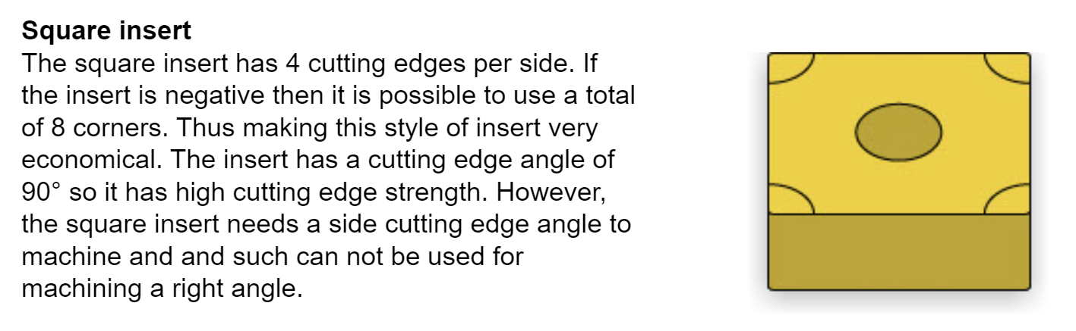
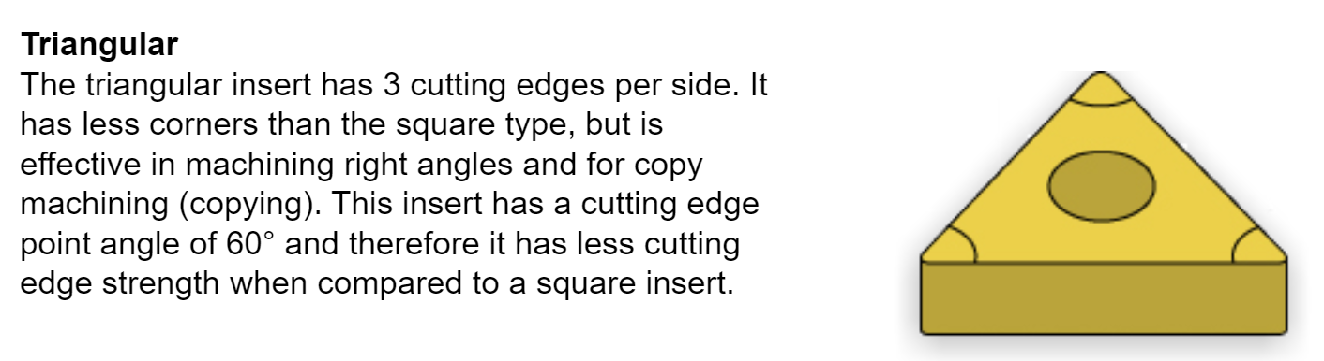
Insert Geometry
Trade Name
SNMG
Trade Name
TNMG

Slide 45
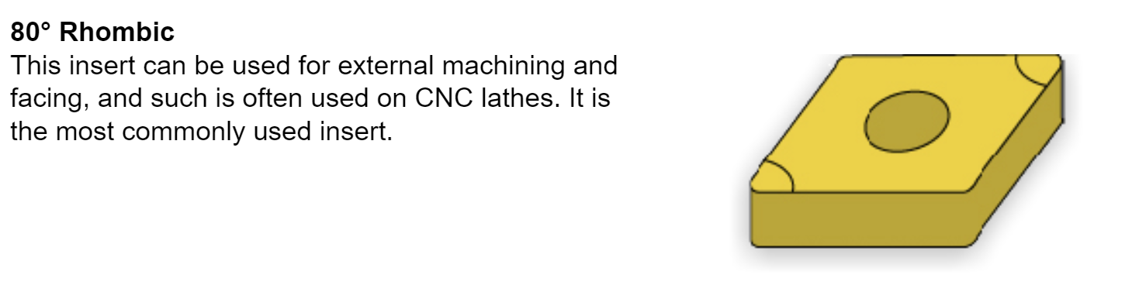
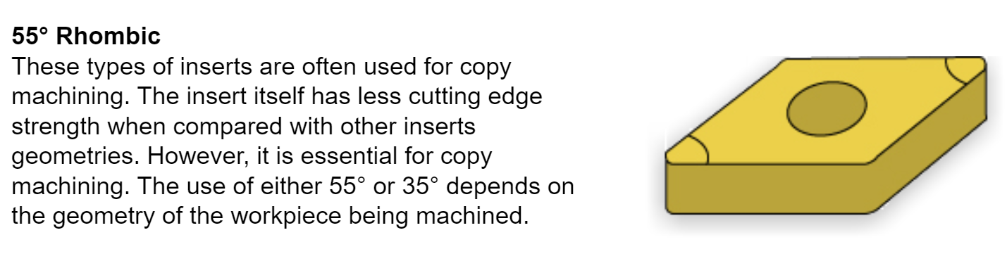
Insert Geometry
Trade Name
CNMG
Trade Name
DNMG

Slide 46
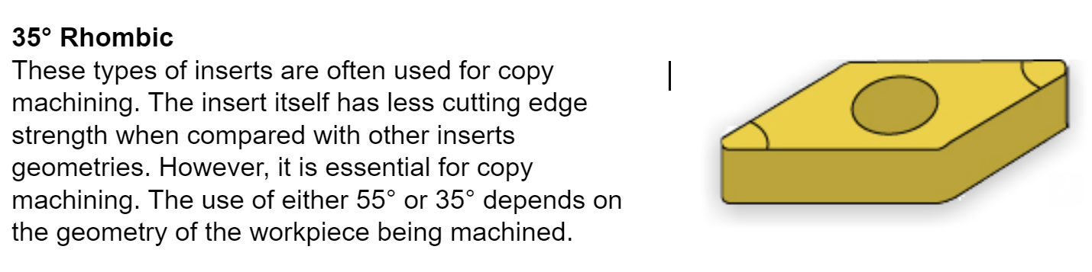
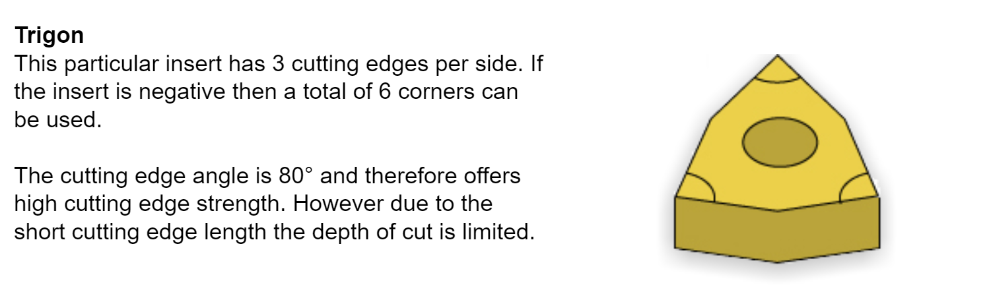
Insert Geometry
Trade Name
VNMG
Trade Name
WNMG

Slide 47
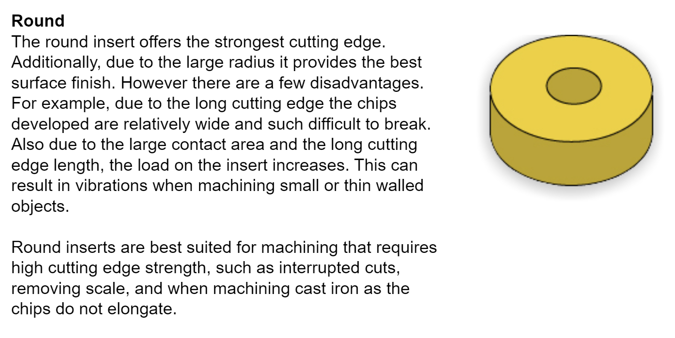
Insert Geometry
Trade Name
WNMG

Slide 48
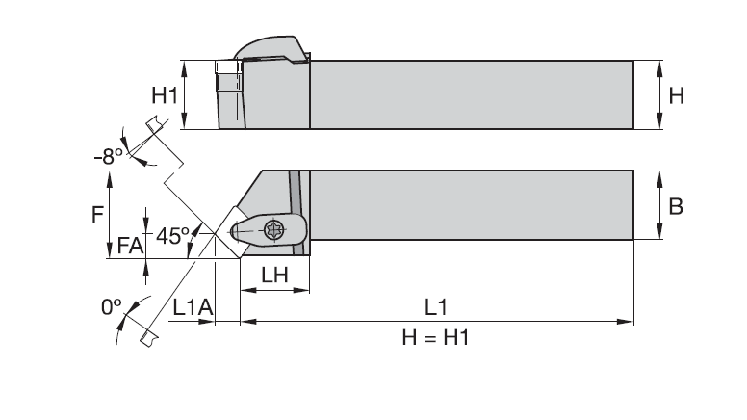
Tool Holder Geometry
Turning
External Turning - Square / Rectangle Bar Type
Centre Offset | Gage Length

Slide 49
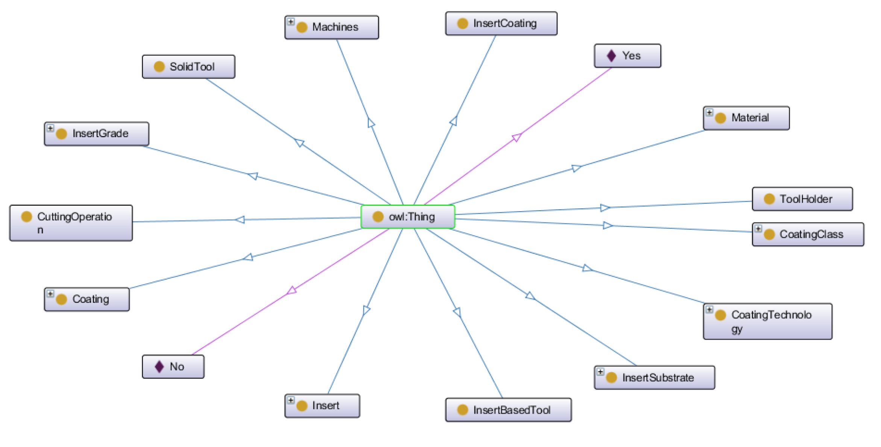
Ontology

Slide 50
Grinding wheel
knowledge representation

Slide 51
Knowledge base
Grinding process
Material and application
Bond
Grade
Geometry
Type
isUsedfor
hasShape
Structure
Grinding wheel
hasBond
isProducedby
Abrasives
Size
Manufacturer
hasAbrasive
Type

Slide 52
Ontology Development
Semantic Web

Slide 53
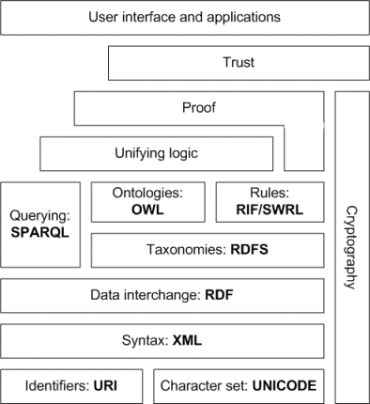
Semantic Web Architecture
Source: https://www.obitko.com/tutorials/ontologies-semantic-web/semantic-web-architecture.html

Slide 54
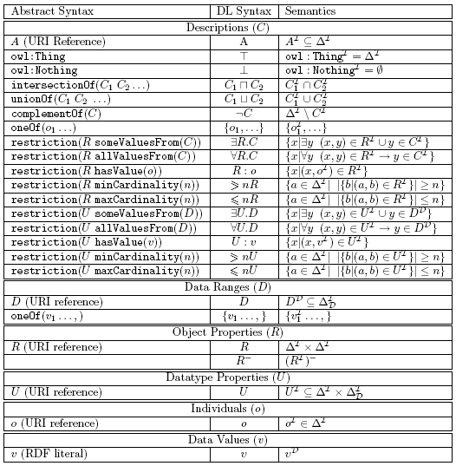
Descriptive Logics
Descriptions data ranges, properties, individuals and data values syntax and semantics
Source: https://www.obitko.com/tutorials/ontologies-semantic-web/owl-dl-semantics.html

Slide 55
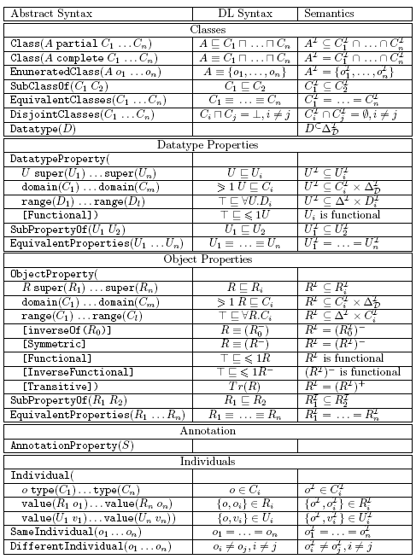
OWL Descriptive Logics - Facts & Axioms
Determining rule set for establishing Facts & Axioms
Source: https://www.obitko.com/tutorials/ontologies-semantic-web/owl-dl-semantics.html

